Slide 1

EASWARI ENGINEERING COLLEGE
Department of Information Technology
PROJECT WORK – FINAL REVIEW
Women Safety Device Using IOT
BATCH 4
SUPERVISOR
Dr. M.HEMA
B.Tech., M.E., Ph.D
ASSISTANT PROFESSOR(Sr.Gr)
BATCH MEMBERS
Reshmi Jaya Soundari R - 310620205075
Yogeswari S – 310620205312
DATE
12-4-24

Slide 2
DEPARTMENT OF IT EEC
AGENDA
Area of Work
Abstract
Objective and Goals
Need for the Work
Literature Survey
Proposed Work
System Architecture
List of Modules
Working Methodology
Sample Input / Output
Output Screenshots
Conclusion
Publication Status
References

Slide 3
AREA OF WORK
DEPARTMENT OF IT EEC
Develop a device for Women’s safety using new technology.
Can also employed for Children’s safety thus preventing crimes like child abuse and child Trafficking
Also used for senior citizens and disabled people suffering from medical issues
Act as Health Monitoring System

Slide 4
ABSTRACT
DEPARTMENT OF IT EEC
Women's safety is a growing concern worldwide, with reports of violence and harassment on the rise. To address this issue, there is a need for innovative solutions that empower women to feel safe and secure. IoT technology offers a promising avenue for developing such solutions, enabling emergency communication and response mechanisms. Many researchers have developed many women's safety devices. However, this paper proposes a novel method to safeguard women from danger as well as shows the health condition of women. It aims to develop a women's safety device using the latest Technologies the Internet of Things (IoT) and Sensors to enhance their security. The proposed device will integrate multiple Sensors like SpO2, Temperature, and GSR with a Microcontroller, GSM communication modules, and GPS Modules to provide emergency alerts. The device will be designed to be compact, wearable, and accessible to women from all walks of life. . This device comes into play when the victim experiences stressful situations. The device uses a wireless sensor network to communicate and send alerts. The GPS and GSM are used to send the user’s location directly to the emergency saved contacts. By integrating these components and functionalities, the device can offer a comprehensive safety solution for women, providing both proactive monitoring and reactive response mechanisms in case of emergencies.

Slide 5
OBJECTIVE AND GOALS
DEPARTMENT OF IT EEC
The relentless pursuit of personal safety, especially in the face of health challenges or unpredictable circumstances, has become an essential aspect of modern living.
As we navigate the complexities of today's world, the demand for proactive measures to safeguard women’s safety and well-being has never been more pronounced.
The primary goal is to leverage IoT technology and sensor data to detect potential safety threats, such as respiratory distress, stress, or extreme temperatures, and trigger appropriate responses. By continuously monitoring vital signs and environmental conditions, the device aims to empower women with real-time alerts and emergency assistance, ultimately fostering a sense of security and confidence in their daily lives.
In response to this, our objective is to develop a wearable safety device that will sense dangerous situations automatically using sensors that empowers women to take control of their health and safety in real-time.

Slide 6
NEED FOR THE WORK
DEPARTMENT OF IT EEC
Many safety devices are there which need to be operated manually which is very difficult for the affected women.
We came up idea of using sensors to detect danger automatically on the basis of temperature change, pulse rate change and change in sweat gland activity.
Incidents of harassment, violence, and medical emergencies highlight the vulnerability faced by women on a daily basis. By leveraging IoT technology and sensor data, such a device can offer proactive monitoring and timely intervention in emergency situations.
Real-time alerts and emergency notifications can empower women to take immediate action or seek assistance when faced with potential threats. Overall, the integration of these technologies addresses the pressing need for women to feel safer and more secure in their surroundings, promoting their well-being and peace of mind.

Slide 7
LITERATURE SURVEY
DEPARTMENT OF IT EEC
Title | Year | Objective | Methodology | Outcome
Raspberry Pi based Women Safety System | 2023 | The device is used to automatically identify certain circumstances and notify the relevant parties. | She can push the button to send the victim's present position in emergency situations | Advantage: Portable Inexpensive Disadvantage: Security Issues
IoT Based Women Safety Device | Jun 2022 | This device includes a panic button that the victim can press if she is in danger | The manual and automated mechanism is the methodology that takes place when the women are ready to reply | Advantage: cost-effective and works in any critical situation. Disadvantage: Security issues
Smart Security Device for Women Based on IoT Using Raspberry Pi | 2021 | the raspberry pi module has been used and a GSM module has been used to send SMS to and track the location | An automatically turning on a device that will create an emergency alarm, send SMS with the live image or video | Advantage: User - Friendly Disadvantage: Wearability Issues

Slide 8
LITERATURE SURVEY
DEPARTMENT OF IT EEC
Title | Year | Objective | Methodology | Outcome
Women Safety Device Using IoT | Oct 2021 | The device uses wireless networks to communicate and to send alerts to them | automated highly reliable security device with advanced sensors embedded in a wearable dress. | Advantage: Compact in size with wireless network. Disadvantage: Wearability issues
Women’s Safety System Using IoT | Mar 2020 | a device that will live positions endlessly additionally sends a message with location to a predefined range | By pressing the switch and by using a sensor when she suddenly falls due to health conditions like fainting | Advantage: this device can be carried everywhere Disadvantage: GPS or Panic Button may not work
SMARISA: A Raspberry Pi based Smart Ring for Women Safety Using IoT | 2018 | It can be activated by the victim on being assaulted just by the click of a button that will show location and capture the image of the attacker | When a woman is in danger, she presses the button that triggers the RaspberryPi that enables the camera to capture the image | Advantage: Accurate Tracking Low cost Disadvantage: Network Issues

Slide 9
PROPOSED WORK
DEPARTMENT OF IT EEC
The proposed system for a wearable safety device represents an advanced and integrated solution that harnesses the power of cutting-edge sensor technologies and IoT connectivity to enhance personal safety, well-being, and health monitoring.
This system aims to offer a comprehensive approach to safety and health management, going beyond the capabilities of the existing systems.
The system design aims to enhance women's safety by leveraging advanced sensor technologies and IoT connectivity for proactive risk mitigation and rapid response.

Slide 10
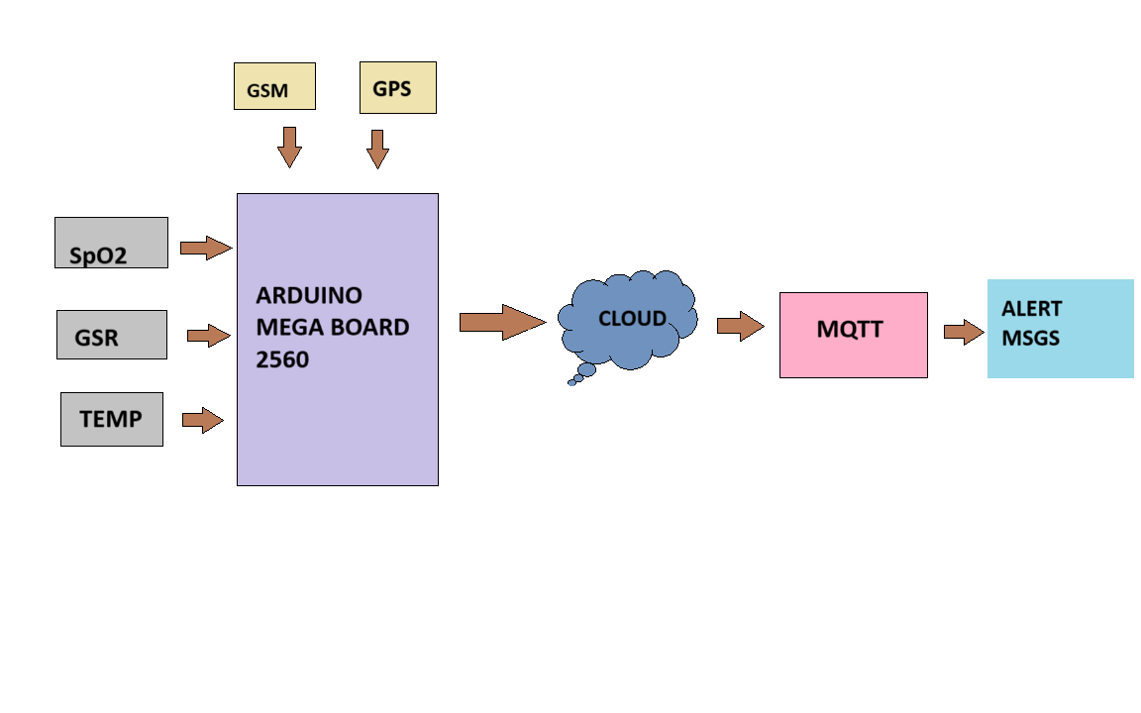
SYSTEM ARCHITECTURE
DEPARTMENT OF IT EEC
Architecture of the Proposed Work

Slide 11
MODULES
DEPARTMENT OF IT EEC
List of Modules for IoT Integration of Device
Wearable Device Module
Processing Module
Software Module

Slide 12
MODULES
DEPARTMENT OF IT EEC
Wearable Device Module It incorporates the following modules:
SpO2 SENSOR
INPUT:
It is known as a pulse oximeter sensor, is a device that measures the oxygen saturation of blood and heart rate from the real time environment . It is connected to the Arduino Mega Board
OUTPUT:
Normal:
SpO2 levels are between 95% and 100%.
Abnormal:
While in danger, the shortness of breath and dizziness, the value will be lower.

Slide 13
MODULES
DEPARTMENT OF IT EEC
B. TEMPERATURE SENSOR
INPUT:
These are worn on the body and monitor temperature continuously. The Temperature sensor is connected to the 34th pin of the Arduino Mega Board
OUTPUT:
Normal:
Body Temperature of the person
Abnormal:
Abnormal Low/High rise in temperature

Slide 14
MODULES
DEPARTMENT OF IT EEC
C. GSR SENSOR
INPUT:
Galvanic Skin Response is a method of measuring the electrical conductance of the skin. This measure is often used as an indicator of emotional arousal, as sweat gland activity increases in response to stress, excitement, and other emotions. The GSR sensor is connected to the 35th pin of the Board
OUTPUT:
Normal:
The emotional response reading should be less than the specific value
Abnormal:
The emotional response reading should be more than the specific value

Slide 15
MODULES
DEPARTMENT OF IT EEC
D. GSM
A GSM is a wireless communication device that allows electronic devices to communicate with each other over the GSM (Global System for Mobile Communications) network.
Function:
Here the Arduino board and the sensors communicate each other through GSM
E. GPS
A Global Positioning System (GPS) is a small electronic device that can receive signals from GPS satellites and determine its location on Earth.
Function:
After the device detects abnormal situation the location is sent to the emergency contacts using GPS

Slide 16
MODULES
DEPARTMENT OF IT EEC
Processing Module
A. Arduino Mega 2560 Board
Arduino board is a hardware board which can read inputs from sensors, button,etc All the 3 sensors are connected to the this board using connecting wires
Function:
It takes the sensor readings, processes it and gives output thus functioning the device. We can connect to Arduino IDE of the laptop using USB port
B. POWER SOURCE
Long-lasting battery or rechargeable battery for extended use. It is connected to the I/O pin of the Arduino Board
Function:
It powers the Arduino board

Slide 17
MODULES
DEPARTMENT OF IT EEC
Software Module
A. Arduino IDE
The Arduino IDE is a software application that helps to write code and upload it to the board. It is a cross-platform application. To write code for the Arduino board, you will need to use C and C++. It is a relatively simple language that is easy to learn, even if you have no prior programming experience.
Function:
The code is written for getting sensor values from the Arduino Board through suitable ports. It measure values under suitable conditions and give output as alerts.This also connects Safety App with suitable constraints.
B. MQTT
MQTT is a system that manages messages between different clients. This includes sending and receiving filtered messages to the identified clients who are subscribed to this system.
Function:
In this device, if the sensor readings were abnormal MQTT sends messages to the subscribed emergency contacts.

Slide 18
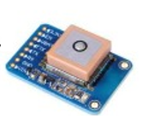

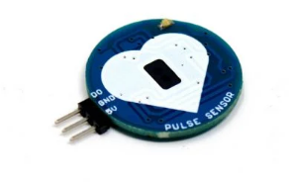
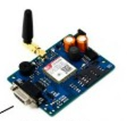
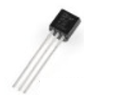
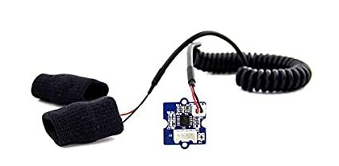
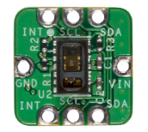
MODEL DIAGRAM
DEPARTMENT OF IT EEC
Model Diagram
GSM Module
PULSE SENSOR
TEMPERATURE SENSOR
GPS Module
SpO₂ SENSOR
GSR SENSOR

Slide 19
WORKING METHODOLOGY
DEPARTMENT OF IT EEC
WORKING METHODOLOGY OF THE DEVICE
The working methodology of this device shows the wearable device i.e. bangle or ring, and the sensors present in that take the readings i.e. heart rate value, temperature value, GSR value, and IR value.
These readings are sent to the Arduino Mega Board which is charged with the power source. The Arduino Mega Board sends the data to the cloud. The Safety app is connected to Arduino software. The code written in Arduino first integrates the app through the Wi-Fi. Then, it takes the readings and access it.
The IR value plays the main role here the code has led the conditions on the range where the person experiences emotional and physical stress levels if this value goes beyond the range, it alerts the device and sends the location to the emergency contacts through the Safety App. This device not only detects for abnormal IR values but also abnormal Temperature and GSR values which in turn alerts and send messages to the Safety app.

Slide 20
WORKING METHOGOLOGY
DEPARTMENT OF IT EEC
The Safety App uses Mqtt, a system that uses messaging protocol for machine-to-machine communications. This App can be used by all. But the contacts to be allowed is to be handled by a person who wears the safety device.
Once the device alerts that the situation is not safe for women it alerts these contacts. It displays the location and physical condition of women. Thus, the device is powerful and safe, unlike the other safety devices. This paper shows how we have implemented the device which is easier for the women to use the device effectively
To make the device accurate we planned to develop an ML algorithm which is Logistic Regression. The collected data is sent to the cloud and ML predicts whether the situation is safe or unsafe. If it is unsafe emergency contacts will be alerted by SMS and location details It is an ML algorithm which gives the probabilities of the event b/w 0 to 1. Instead of giving the true/false values it gives the probabilities that the event has occurred or not. Machine Learning (ML) holds immense potential in enhancing the effectiveness and intelligence of women safety devices.

Slide 21
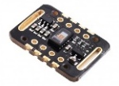

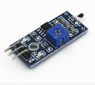
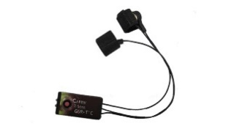
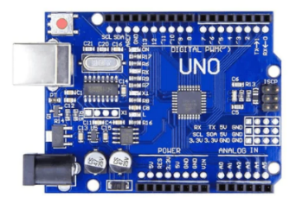
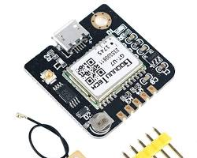


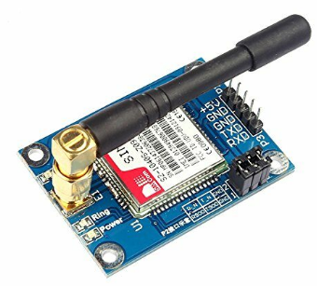
WORKING DIAGRAM
DEPARTMENT OF IT EEC
Sensor in Arduino Uno Board Record abnormal Reading
SENSORS
App in the Mobile send Alert Message with GPS Location
Arduino Uno Board
When an assault occurs then..
GPS
Emergency Contacts will receive Alert Messages
GSM
Working Model

Slide 22
SAMPLE INPUT / OUTPUT
DEPARTMENT OF IT EEC
PRODUCT SAMPLE I/O
INPUT
Temperature, GSR, IR, and Heart Rate values in a wearable device
OUTPUT
The alert sounds with messages along with GSM And GPS location

Slide 23
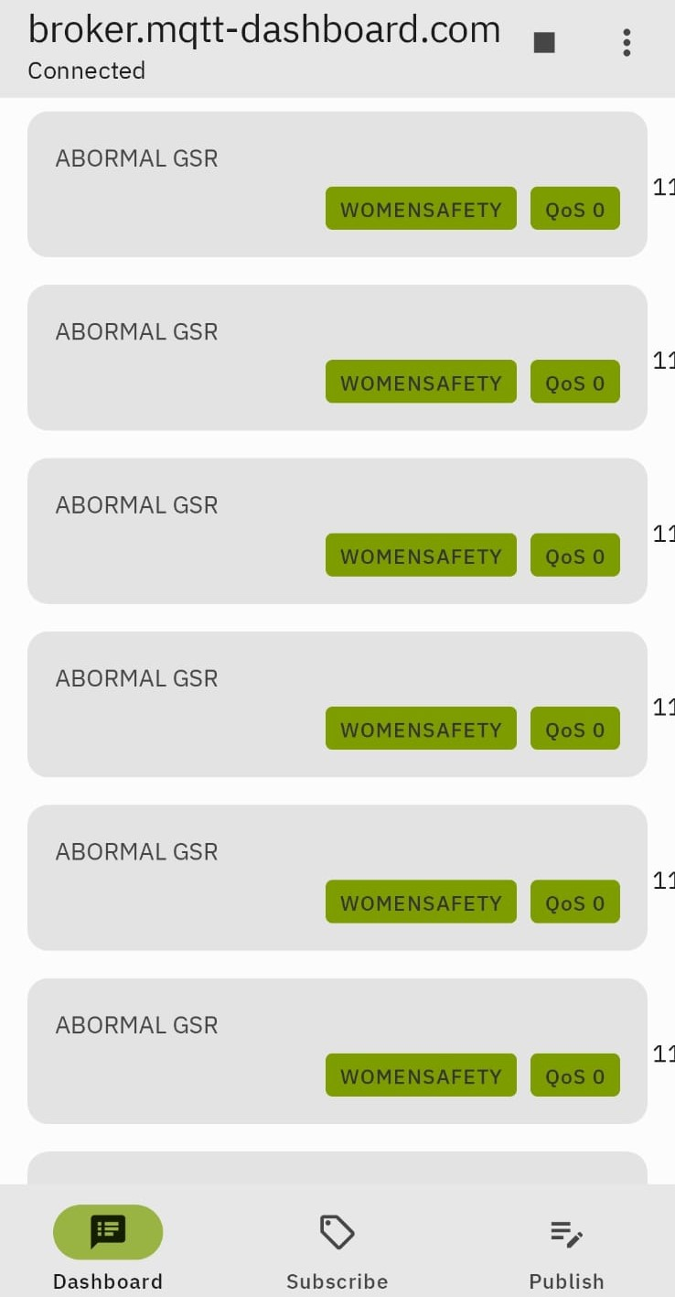

OUTPUT SCREENSHOTS
DEPARTMENT OF IT EEC
Code in Arduino IDE I/O
24

Slide 24
CONCLUSION
DEPARTMENT OF IT EEC
In conclusion, the integration of enhanced sensors like the GSR (Galvanic Skin Response), temperature sensor, and SpO2 (Blood Oxygen Saturation) sensor into women safety devices leveraging IoT technology represents a significant step forward in addressing safety concerns effectively. These sensors offer valuable insights into physiological responses and environmental conditions, enhancing the device's ability to detect and respond to potential threats.The IoT framework facilitates seamless connectivity and data exchange, enabling real-time monitoring, remote alerting, and emergency response functionalities. Through IoT, these safety devices can transmit sensor data to centralized platforms or mobile applications, enabling rapid response from authorities or designated contacts in case of emergencies. However, it's crucial to address privacy, security, and usability concerns to ensure widespread adoption and effectiveness. With further research, development, and collaboration, these innovative solutions have the potential to significantly impact women's safety and well-being.

Slide 25

PAPER PUBLICATION STATUS
DEPARTMENT OF IT EEC
Publication Proof in Intelligent Journal of Intelligent Systems and Applications in Engineering (IJISAE)

Slide 26
REFERENCES
DEPARTMENT OF IT EEC
[1] Barukam Vamshikrishna Yadav, A. Viji Amutha Mary, Mercy Paul Selvan, S. Jancy, L. Suji Helen, "Arduino based Women Safety Tracker Device", 2023 7th International Conference on Trends in Electronics and Informatics (ICOEI), pp.433-436, 2023.
[2] Kiran Kumar Kommineni, Shaik Johny Basha, M Sandeep, Pittala Susmitha Vadana, Thota Siva Ratna Sai, Duggirala Syam Kumar, "A Review on IoT-based Defensive Devices for Women Security", 2023 9th International Conference on Advanced Computing and Communication Systems (ICACCS), vol.1, pp.99-104, 2023.
[3] Ahir, S., Kapadia, S., Chauhan, J. and Sanghavi, N., 2018, January. The personal stun-a smart device for women's safety. In 2018 International Conference on Smart City and Emerging Technology (ICSCET) (pp. 1-3). IEEE.
[4] Huang, L., Zhou, M., Hao, K. and Hou, E., 2019. A survey of multi-robot regular and adversarial patrolling. IEEE/CAA Journal of Automatica Sinica, 6(4), pp.894-903.
[5] Sowmya, T., Triveni, D., Keerthana, D., Lakshmi, A.V., Priya, K.P. and Kavya, G., 2020. Women’s Safety System using IoT. International Journal of Science and Technology.

Slide 27
DEPARTMENT OF IT EEC
THANK YOU

